Slide 1


Egyptian Space Agency
Egyptian Universities Training Satellite Project
EUTS
Anomaly Detection for Satellite Telemetry Data Using Machine Learning
Prepared by
Helwan University
Computer and Artificial intelligence–Computer Science T42

Slide 2
Introduction
Project Idea: detect of telemetry data that come from satellites with using of machine learning algorithms,
Telemetry data is set of measurement and reading of embedded device Across time interval
In this project ,we use two dataset consist of Date and Temperature records ,after preprocessing dataset we use time series and machine learning algorithm to detect future temp

Slide 3
About Data

Slide 4
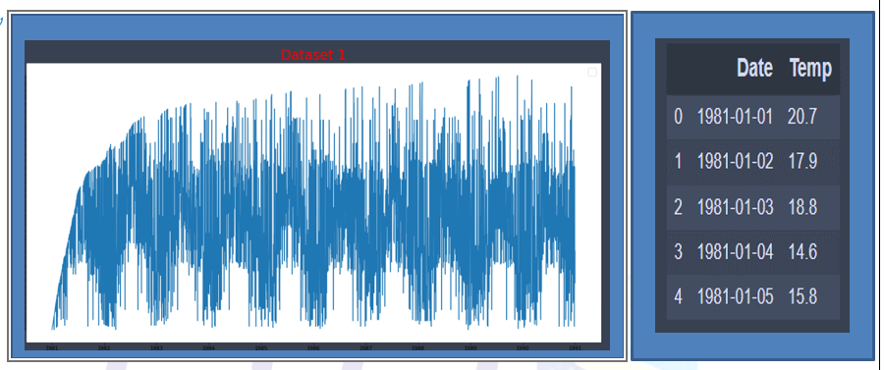
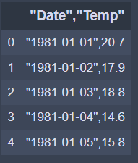
Dataset 1
dataset 1 consists of one column "Date","Temp" and we try to separate them into two columns ‘Date’ , ‘temp’

Slide 5
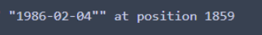
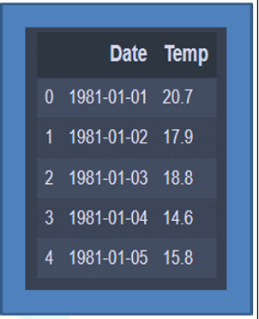
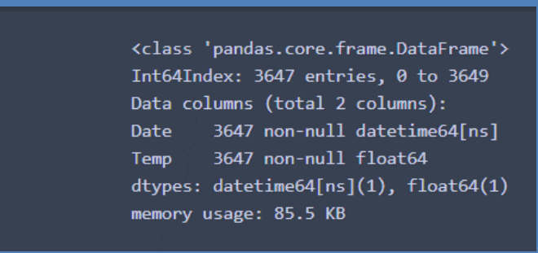
Dataset 1 Preprocessing
Dataset 1 consists of one column "Date","Temp" and we try to separate them into two columns ‘Date’ , ‘temp’
Convert temp column data type from string to float
Convert Date column data type from string to Datetime
Drop Null values and check for Duplicated
Finally data after Cleaned

Slide 6
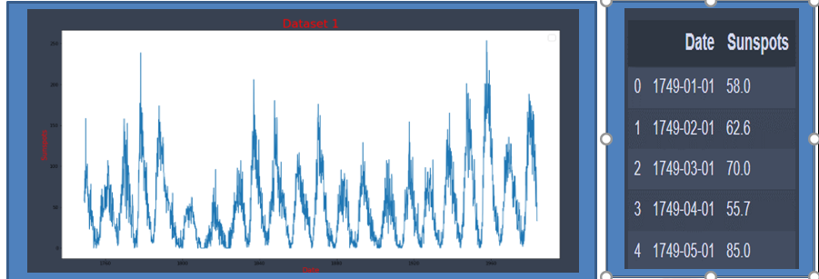
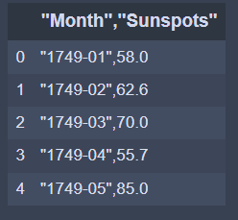
Dataset 2
dataset 2 it consists of one column "Month","Sunspots" "Date","Temp" we try to seprate this column into two column Date and Sunspots

Slide 7
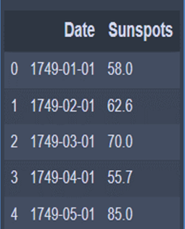
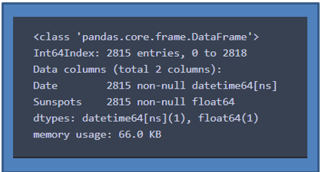
Dataset 2 Preprocessing
dataset 2 it consists of one column "Month","Sunspots" "Date","Temp" we try to separate this column into two column Date and Sunspots
convert data type for Sunspots from String to float
Convert Date column data type from string to Datetime
we found two issue at index 7 where year and month are swapped ,at index 489 invalid month
Drop Null values and check for Duplicated
Finally dataset look like

Slide 8
ARIMA Model

Slide 9

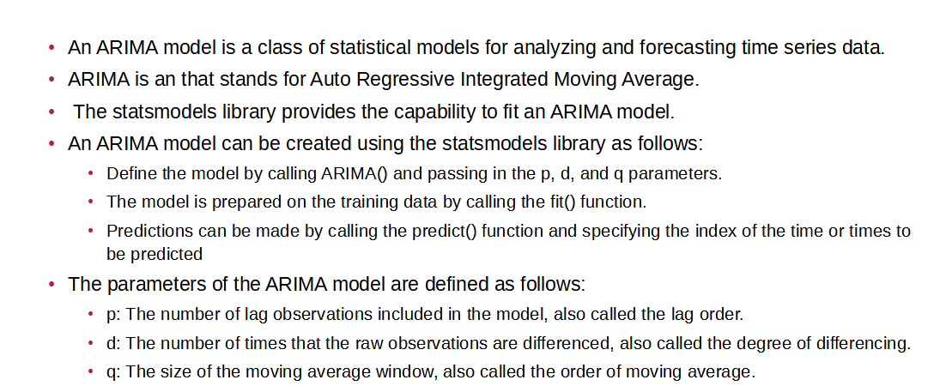

Slide 10
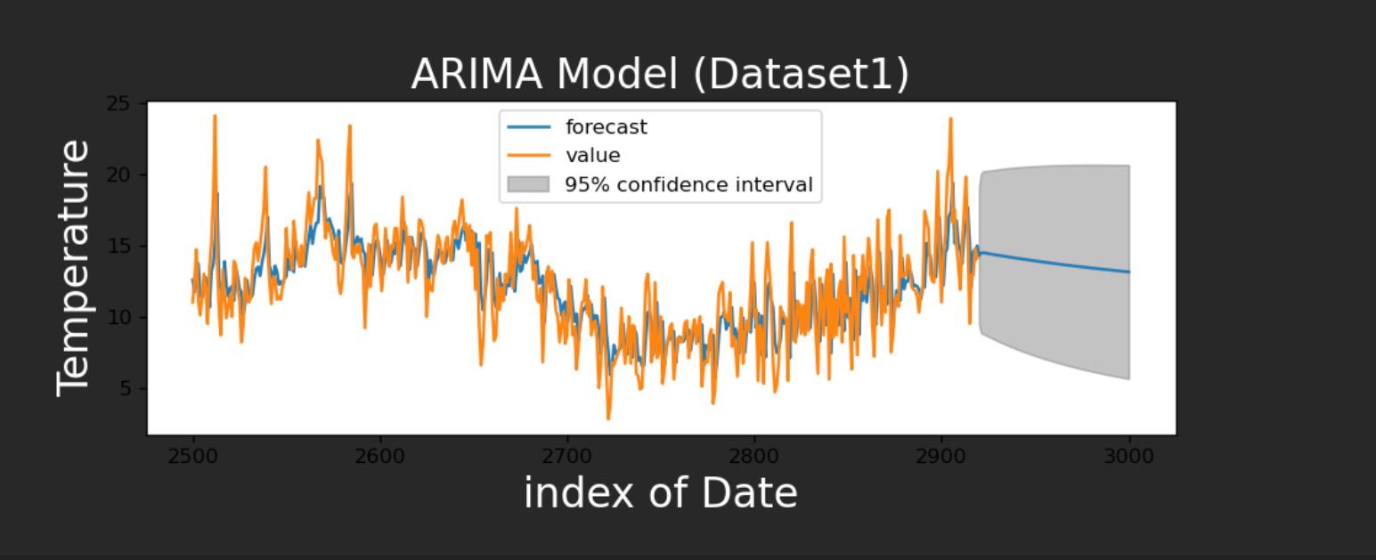
Result “Mean Square Error:4.01

Slide 11
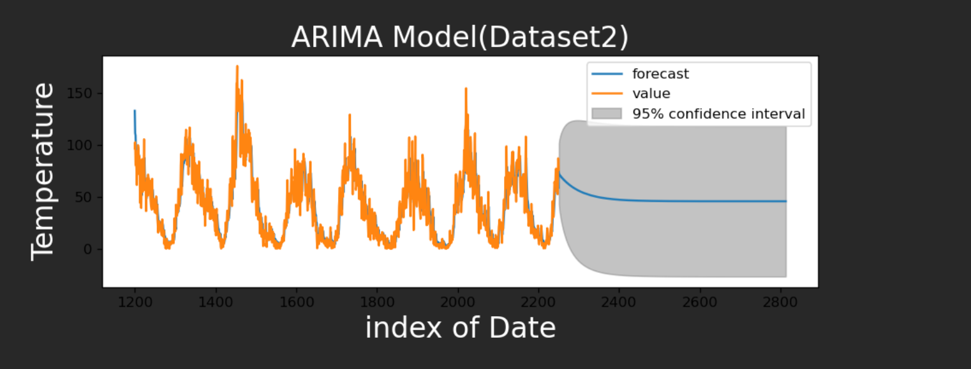

Slide 12
ARMA Model

Slide 13

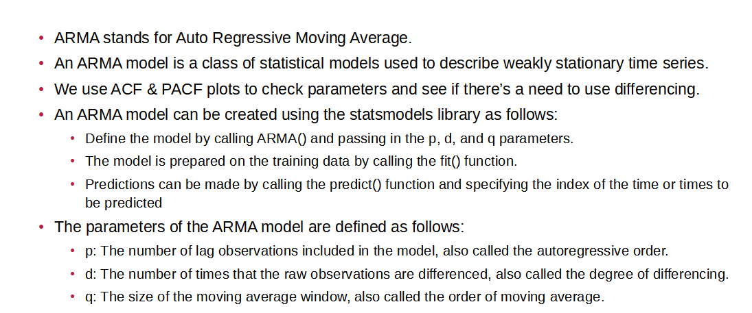

Slide 14
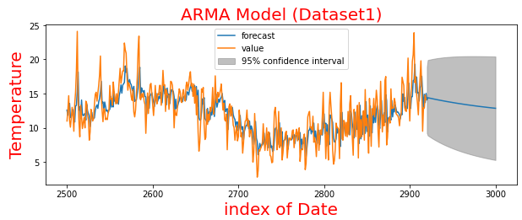
Result “Mean Square Error:3.987

Slide 15
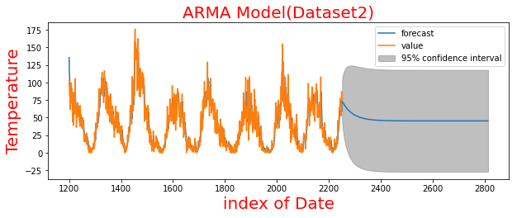
Result “Mean Square Error:62.247

Slide 16
SES Model

Slide 17
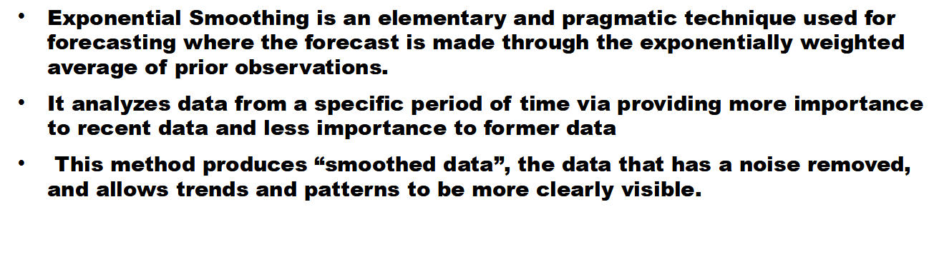
INTRODUCTION TO SES

Slide 18
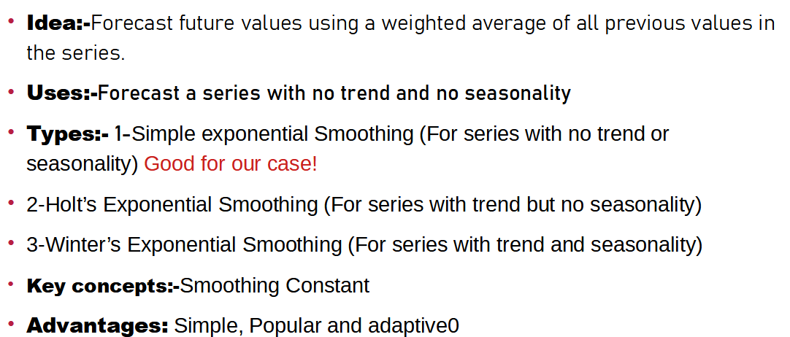

Slide 19
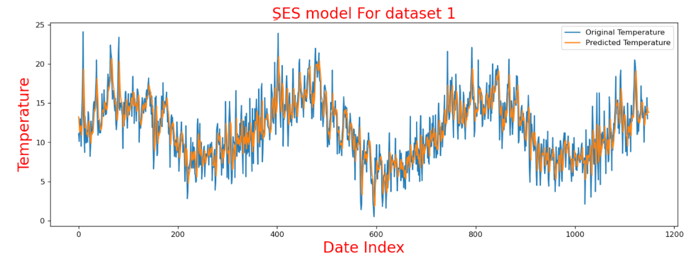


Slide 20
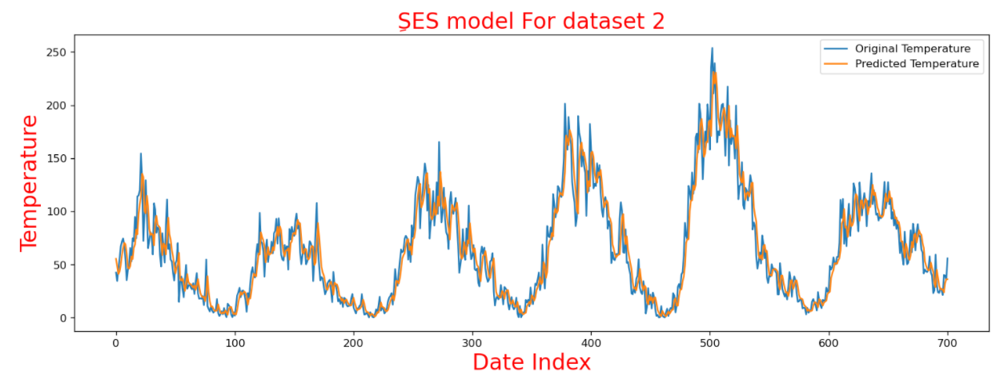
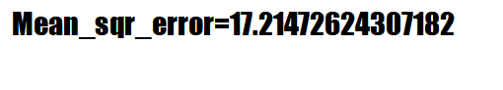

Slide 21
ARIMA Model

Slide 22
INTRODUCTION TO SES
Exponential Smoothing is an elementary and pragmatic technique used for forecasting where the forecast is made through the exponentially weighted average of prior observations.
It analyzes data from a specific period of time via providing more importance to recent data and less importance to former data
This method produces “smoothed data”, the data that has a noise removed, and allows trends and patterns to be more clearly visible.
The weight of each parameter, or decrease in weight is always determined by smoothing parameter, called as 𝜶 (alpha - single parameter/hyperparameter).
The value of 𝜶(alpha) lies between 0 to 1 such that;
𝜶(alpha)=0: signifies that future forecasted values are the average of historical data (giving more weights to historical data)
𝜶(alpha)=1: signifies that future forecast values are the results of the recent observation (giving more weights to recent observations).

Slide 24
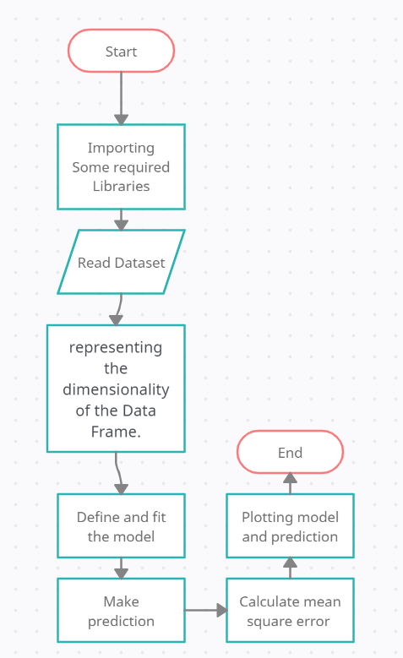

Slide 25
Plotted graph of first dataset
Mean_sqr_error=2.16876874275847

Slide 26
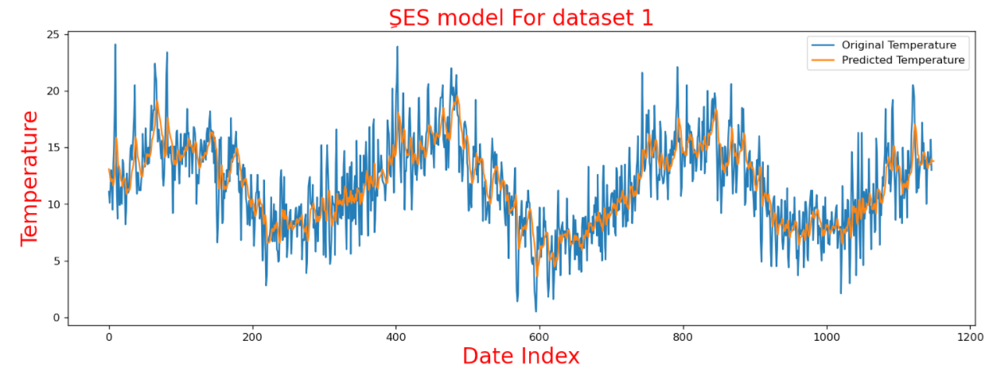
Plotted Graph of first dataset with alpha=0.2
Mean_sqr_error=2.010276443080201

Slide 27
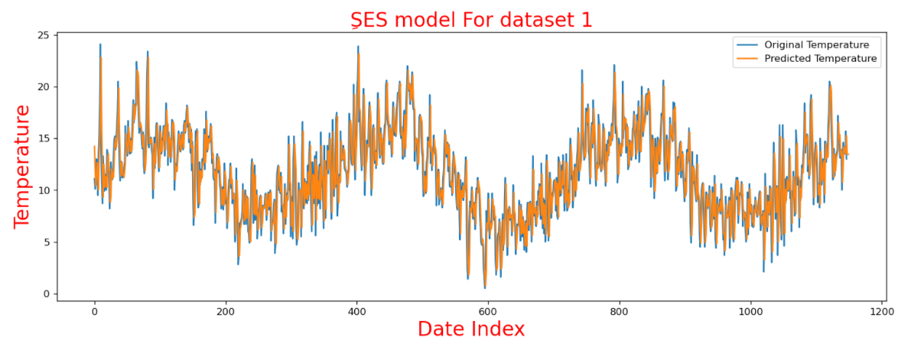
Plotted Graph of first dataset with alpha=0.8
Mean_sqr_error=2.943970631017748

Slide 28
Plotted graph of second dataset
Mean_sqr_error=17.21472624307182

Slide 29
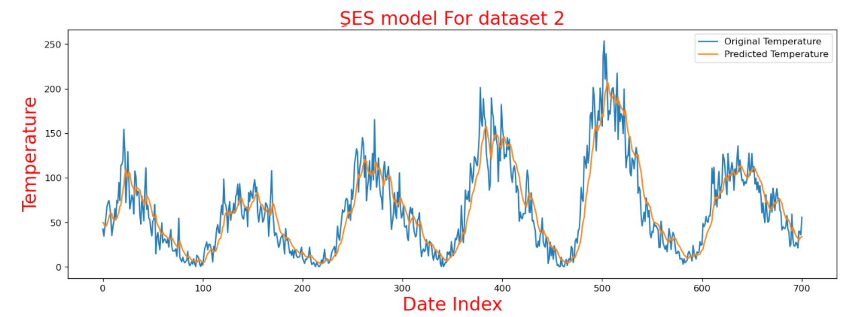
Plotted graph of second dataset with aplha=0.2
Mean_sqr_error=20.349995504549714

Slide 30
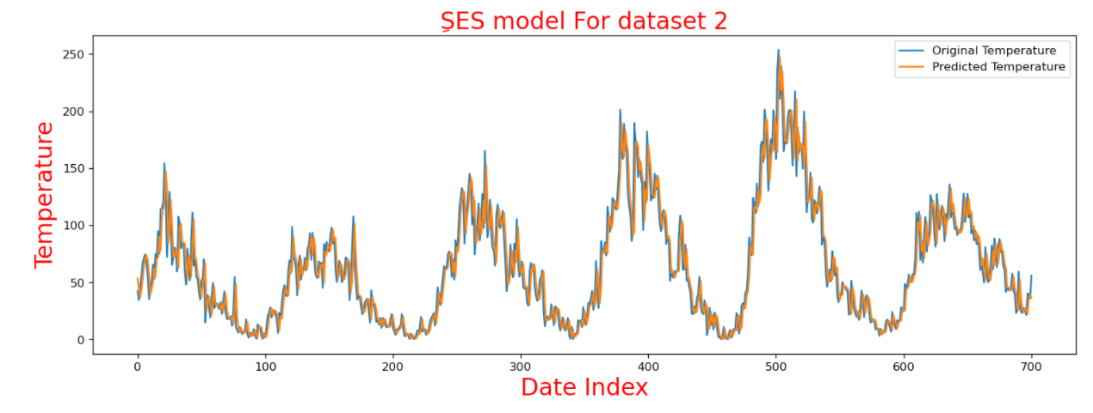
Plotted graph of second dataset with aplha=0.8
Mean_sqr_error=17.374454299005553

Slide 31
LSTM Model

Slide 32
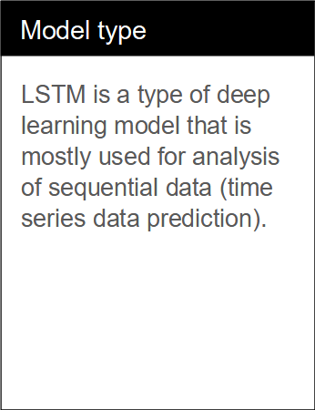
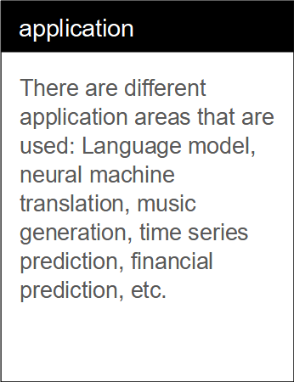
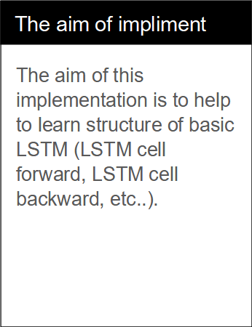

Slide 33



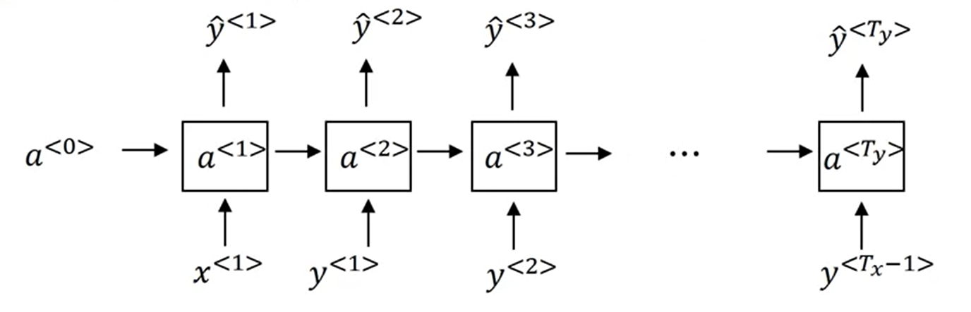

Slide 34
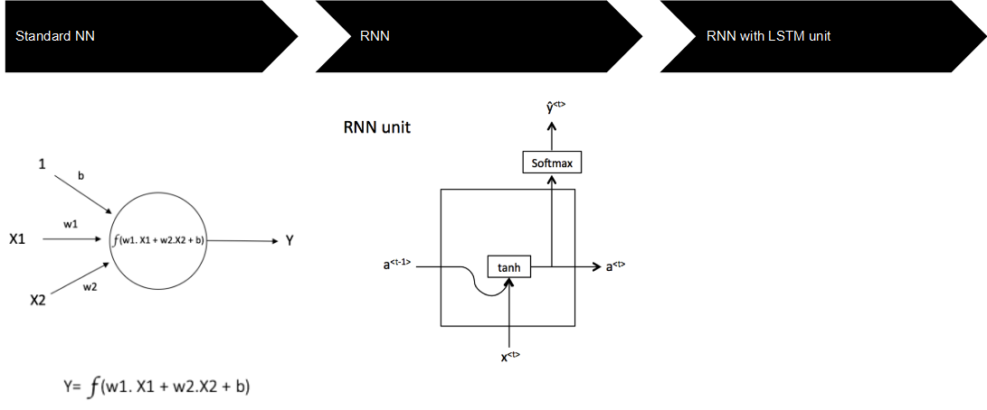
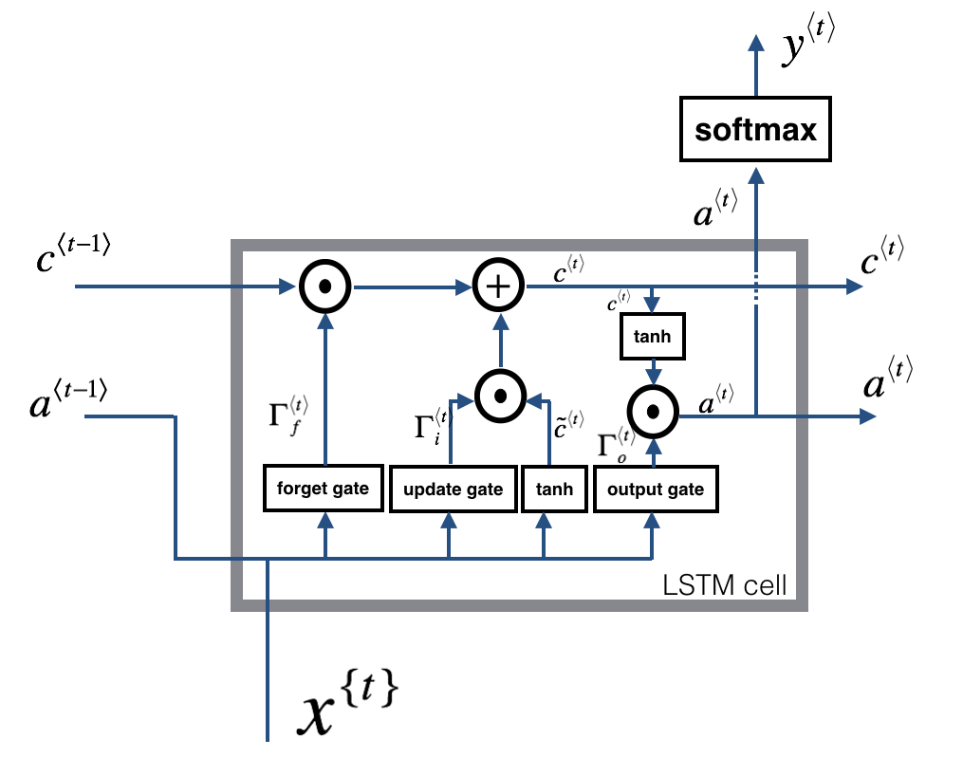

Slide 35
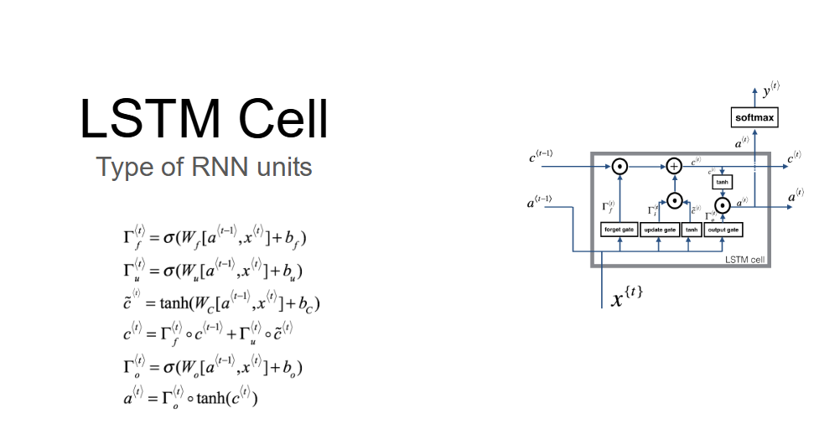

Slide 36
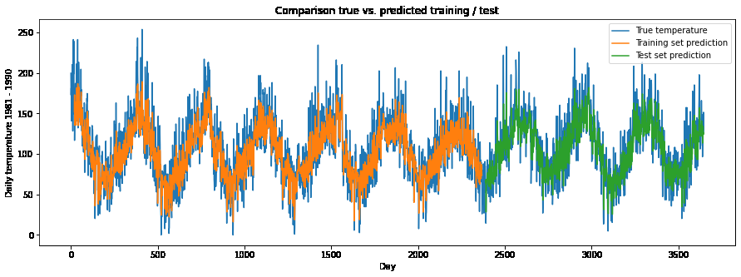

Slide 37
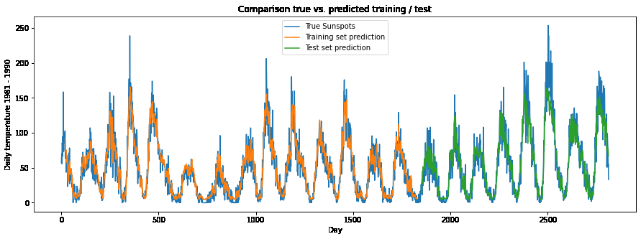

Slide 38
XGBOOST Model

Slide 39
Description
XGBoost is an efficient implementation of gradient boosting for classification and regression problems.
XGBoost can also be used for time series forecasting, although it requires that the time series dataset be transformed into a supervised learning problem first.

Slide 40
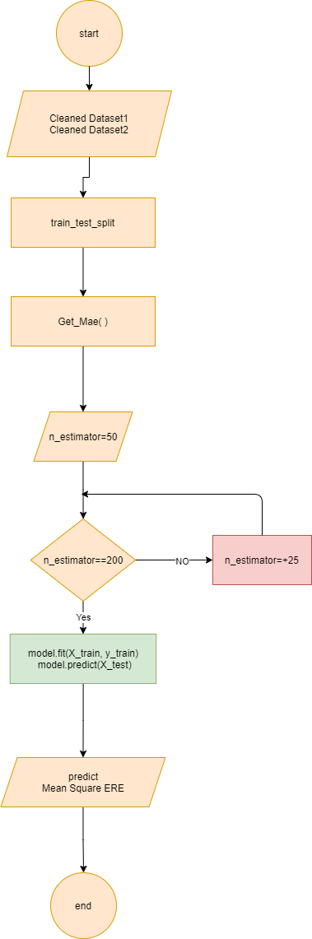

implemented in project
-First thig we Give Index Instead of Data to use XGBoost
-then, we split data to train and test with size 0.8 to train and without random state
- we try to find the best n_estimator through mean square error calculation then we select Best n_estimator for Dataset 1 is 100 and Dataset 2 is 70
-after that we predict our data and here is the prediction result on plot:

Slide 41
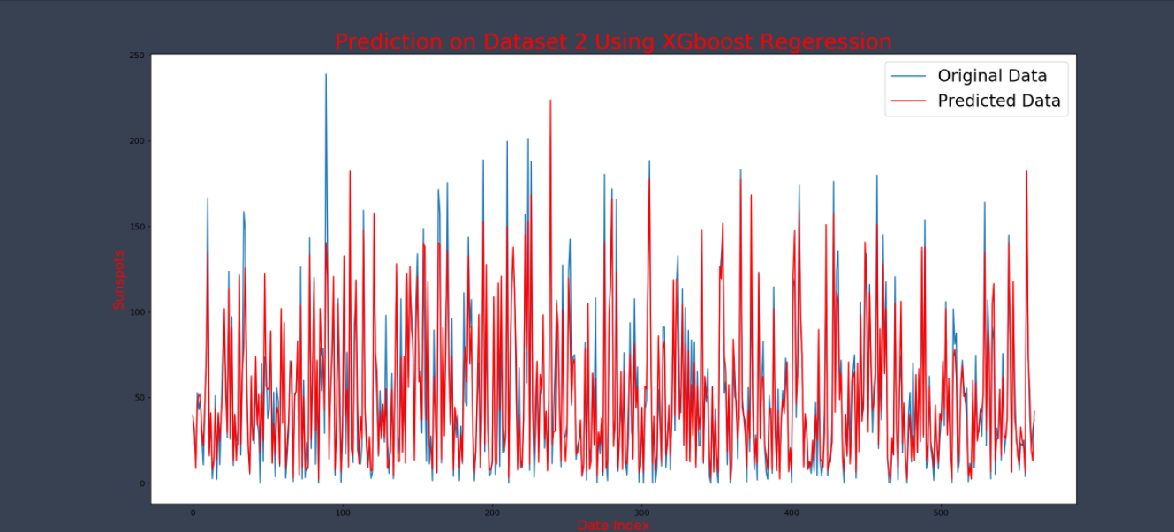
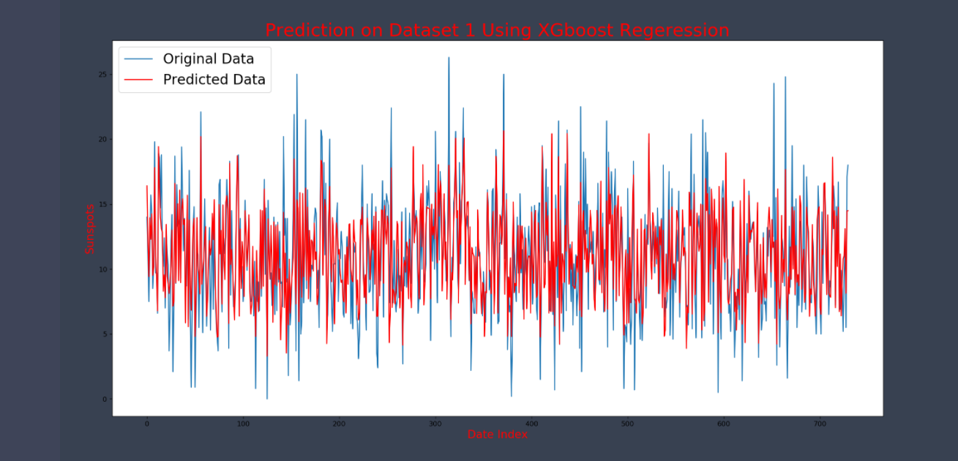

Slide 42
GRU Model

Slide 43
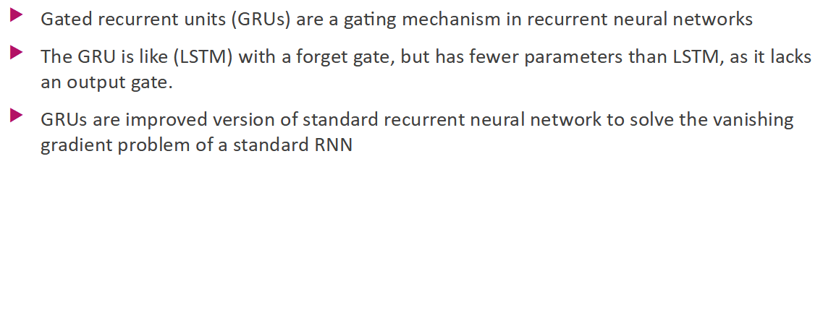

Slide 44
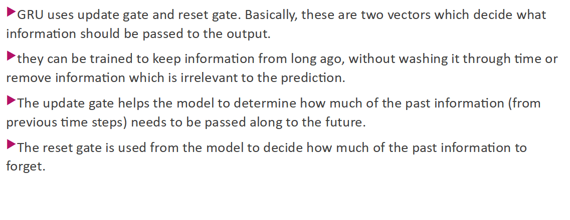

Slide 45
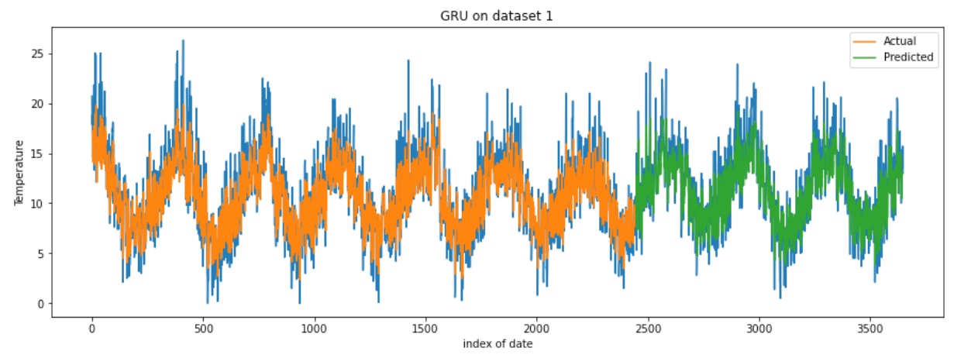

Slide 46
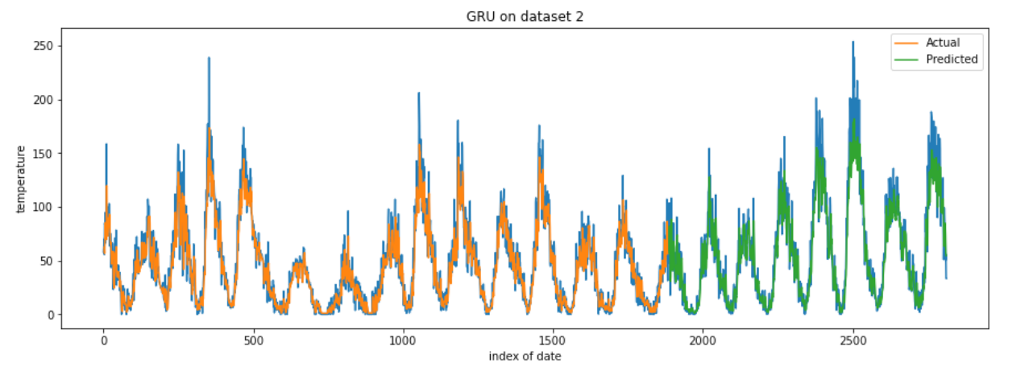

Slide 47
